Slide 1
ANALYSING Misinformation Dataset TO SPOT THE TRENDS
BY FUZZY SHAHIDI
ARRIL 2, 2023

Slide 2
BACKGROUND OF THE PROBLEM AND MOTIVATION
The spread of false information can manipulate people's perceptions of reality, influence politics, and intensify social conflicts.
1
There is a Misinformation dataset over 79,000 articles, consisting of true articles and articles of misinformation from various sources.
2
With the help of this collection, we can spot trends in the dissemination of false information and create fresh tactics to stop it.
3

Slide 3
What I will cover
1
2
3
Overview
Pre-processing
Visualization
Some statistics and summarization
Steps to prepare the dataset
Analyzing the data to spot the trends

Slide 4
Over view of the database
# Rows
# Rows
34,946
43,642
# Sentence
# Sentence
821,955
749,699
# Unique Sentence
# Unique Sentence
787,223
526,615
# Words (unique words)
# Words (unique words)
18,998,671(158,237)
19,311,894 (278,551)
AVG word /sentence
AVG word /sentence
23
26

Slide 5
Summaries of databases
2018 will be a great year for America! As our Country rapidly grows stronger and smarter, I want to wish all of my friends, supporters, enemies, haters, and even the very dishonest Fake News Media, a Happy and Healthy New Year. (35.0%)
As our Country rapidly grows stronger and smarter, I want to wish all of my friends, supporters, enemies, haters, and even the very dishonest Fake News Media, a Happy and Healthy New Year, President Angry Pants tweeted. (32.0%)
As we say goodbye to an incredibly successful 2017, led by an incredibly successful President, we d like to thank President Trump for the incredible sacrifices he s made on behalf of every American (even those who don t yet understand) to Make America Great Again! President Trump tweeted: As our Country rapidly grows stronger and smarter, I want to wish all of my friends, supporters, enemies, haters, and even the very dishonest Fake News Media, a Happy and Healthy New Year. (22.0%)
When they return from the holidays on Wednesday, lawmakers will begin trying to pass a federal budget in a fight likely to be linked to other issues, such as immigration policy, even as the November congressional election campaigns approach in which Republicans will seek to keep control of Congress. (33.0%)
Congress, who voted this month for a huge expansion of the national debt to pay for tax cuts, called himself a “fiscal conservative” on Sunday and urged budget restraint in 2018. (26.0%)
Representative Mark Meadows, speaking on CBS’ “Face the Nation,” drew a hard line on federal spending, which lawmakers are bracing to do battle over in January. (23.0%)

Slide 6
Preprocessing
Punctuation
Extra spaces
Fixed contractions
Unicode
Lemmatization using spacy library
URLs

Slide 7
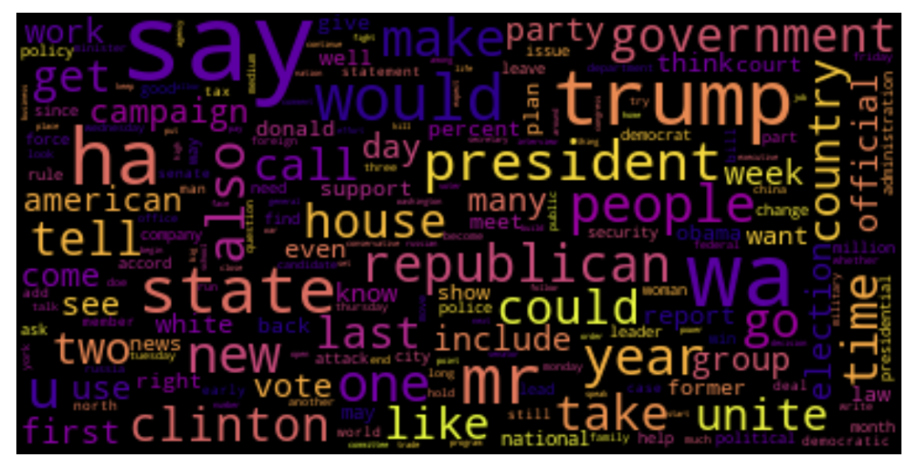
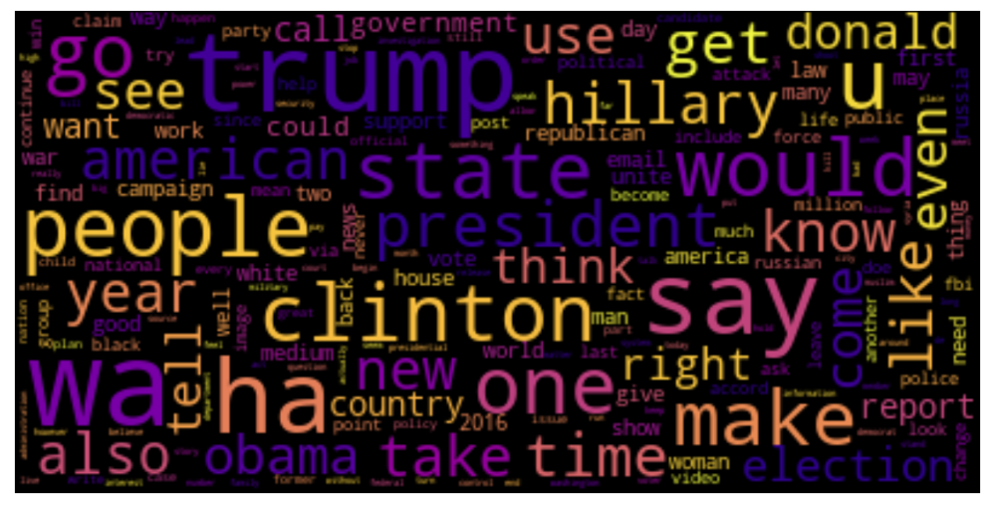
True News
Word Cloud of the most frequent word
Fake News

Slide 8
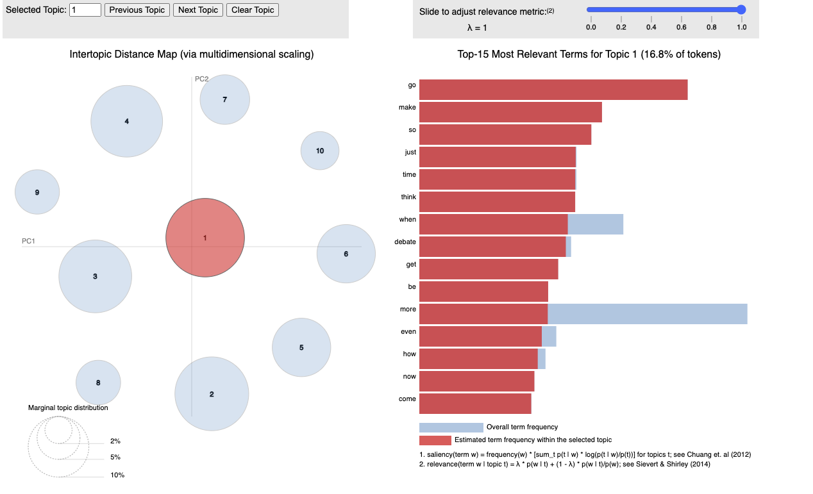
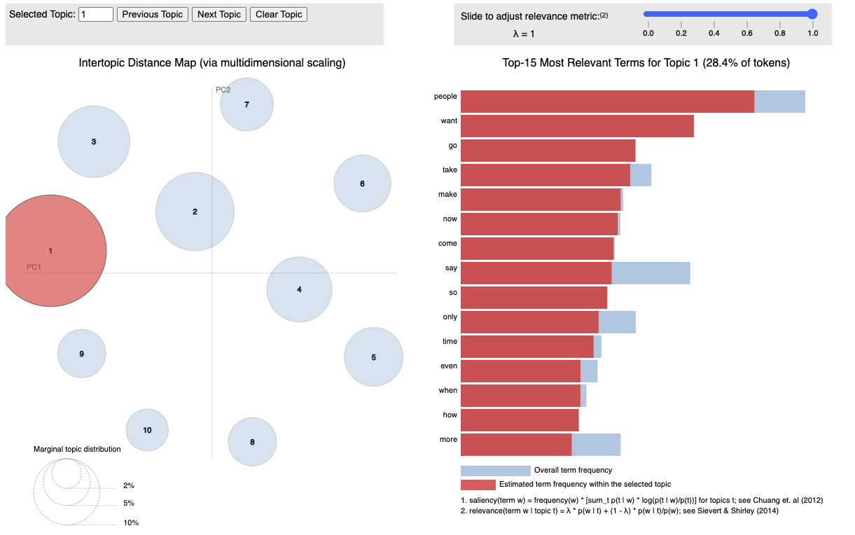
True News
Fake News

Slide 9
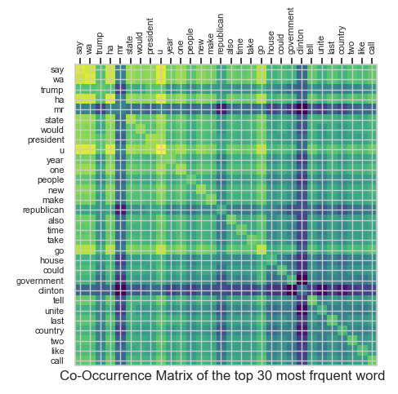
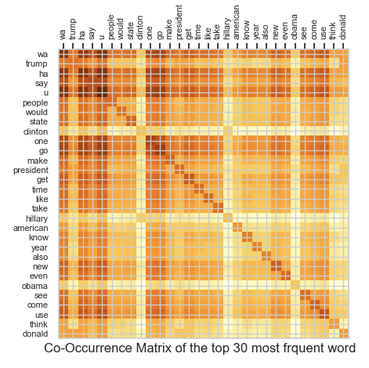
True News
Fake News

Slide 10
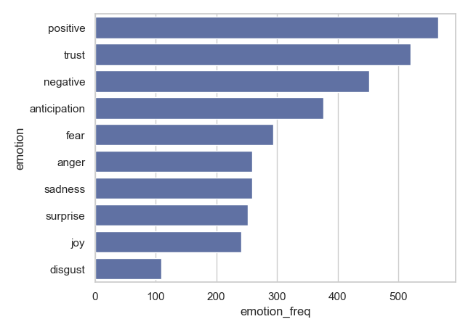
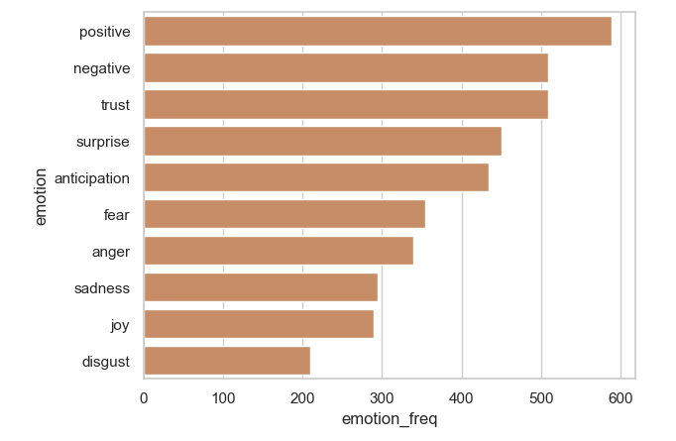
Emotion Analysis of 1,000 sentences of each article
True News
Fake News

Slide 11
Thanks
Question?
https://github.com/Fuzzy-sh
https://www.linkedin.com/in/fuzzy-shahidi/

